Slide 1
JAVA Programming {
Hiveed.java
JAVA PROGRAMMING ;
/* Here is where your journey for your dream begins */
}
JAVA Programming

Slide 2
Table Of ‘Contents’ {
01
02
03
Hiveed.java
JDK installation;
JAVA Architecture ;
JAVA Program Execution ;
}
JAVA Programming

Slide 3

Steps to install eclipse:
Hiveed.java
Step 1 :
Open your browser and type https://www.eclipse.org/
JAVA Programming

Slide 4

Hiveed.java
Step 2 :
Then, click on the “Download” button to download Eclipse IDE.
JAVA Programming

Slide 5
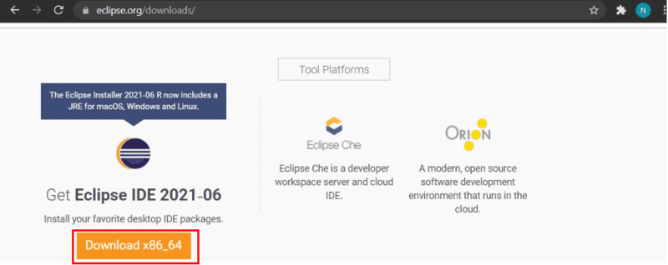
Hiveed.java
Step 3 :
Now, click on the “Download x86_64” button.
JAVA Programming

Slide 6
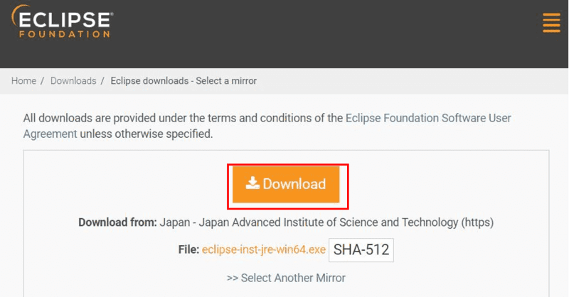
Hiveed.java
Step 4 :
Then click on the “Download” button. After clicking on the download button the .exe file for the eclipse will be downloaded.
JAVA Programming

Slide 7
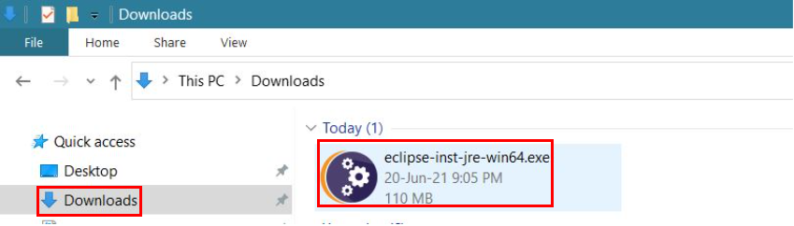
Hiveed.java
Step 5 :
Now go to File Explorer and click on “Downloads” after that click on the
“eclipse-inst-jre-win64.exe” file for installing Eclipse IDE.
JAVA Programming

Slide 8
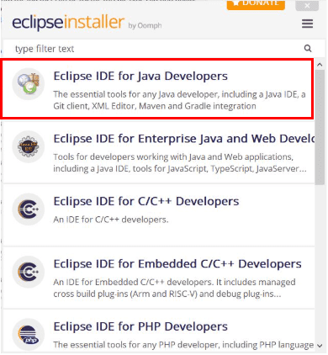
Hiveed.java
Step 6 :
Then, click on “Eclipse IDE for Java Developers”.
JAVA Programming

Slide 9
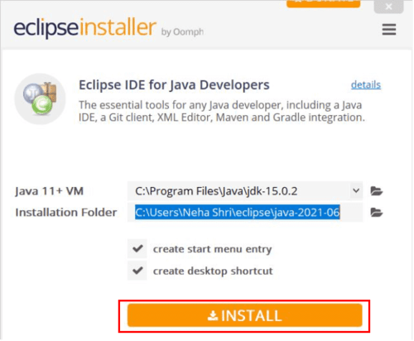
Hiveed.java
Step 7 :
Then, click on the “Install” button.
JAVA Programming

Slide 10
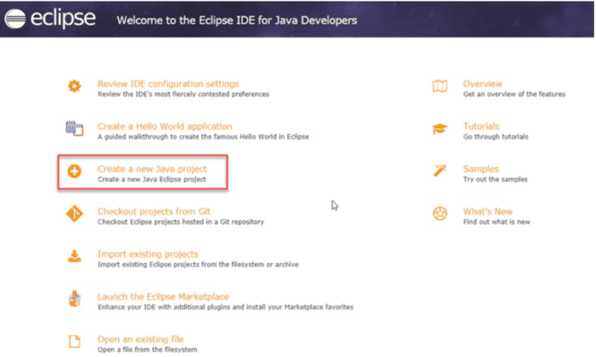
Hiveed.java
Step 8 :
Now click on “Create a new Java project”.
JAVA Programming

Slide 11
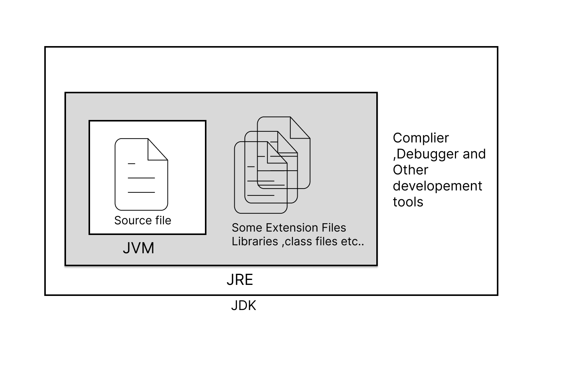
JVM Architecture :
Hiveed.java
JAVA Programming

Slide 12





Program Execution :
Hiveed.java
Complier
User
Hello.java
Translator
Executable file
(byte code)
Laptop / cpu
JAVA Programming

Slide 13
Terminology:
Hiveed.java
Compiler :
It is a translator which is used to convert H.L.L to L.L.L and also it will check for the errors and if it finds any error it will through a error message, otherwise it will provide output.
Libraries :
It’s a collection of pre-defined interfaces. API’s & Classes.
API :
Application Programming Interface. Collection of essential resources, software which is used to develop a Java application.
JAVA Programming

Slide 14
JVM :
Hiveed.java
call
JIT
Executable file
java
It is interpreter.
It will translate byte code to binary’s.
It will read line-by-line understand and translates.
Java virtual machine(JVM)
JAVA Programming

Slide 15
Hiveed.java
JRE :
Java run-time environment. It is a software which will provide an environment to execute JAVA program.
JIT :
Just in time, It is a tool which helps JVM to optimize the bytecode.(JIT will present inside JVM) .
Class loader :
loading class from hard disk to execution area.
Interpreter:
It is a program that converts high level language to low level language. It will check the code line by line.
Why we need JDK?:
We need JDK to compile and execute because it contains java compiler and JVM.
JAVA Programming

Slide 16
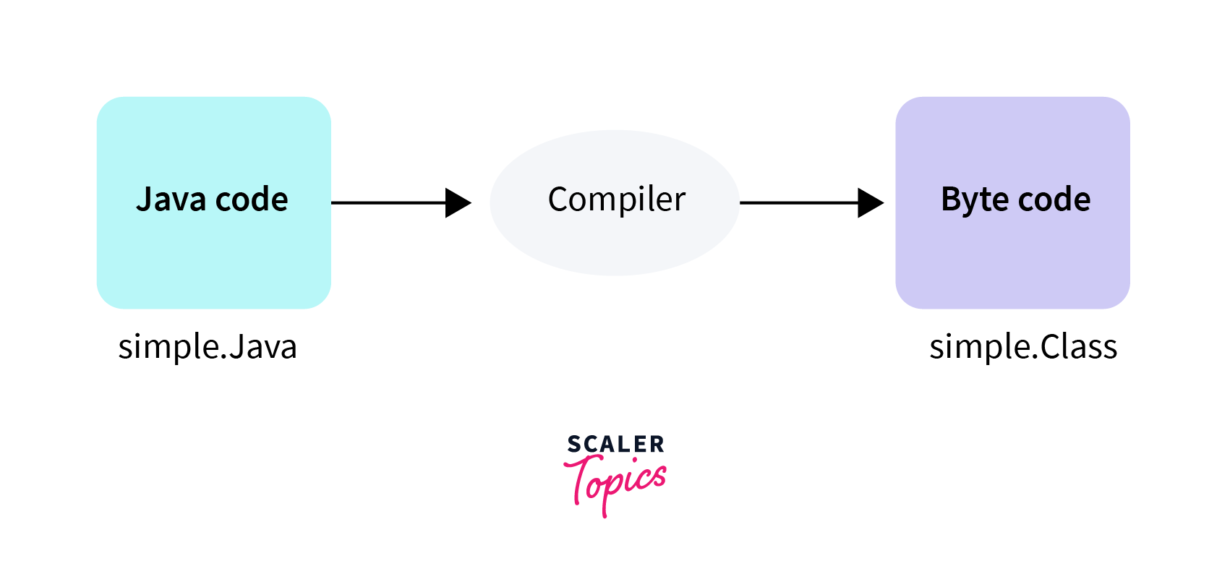
Compile Time :
Hiveed.java
Compiler :
The time taken by the compiler to check the code and some instruction. In order to obtain class file (or) executable file.
In compile time, if code is correct it is C.T.E (Compile Time Error).
JAVA Programming

Slide 17
Run Time :
Hiveed.java
The time take by JVM to convert byte code to binary’s is called run-time.
In run-time decision is done by JVM.
The performance of conversion from byte code to binary’s is increased by JIT.
JAVA Programming

